Slide 1
The secret to understanding and supporting repeated patterns of behavior in infants and toddlers.
Play Schemas:
Jade Teachey & Kelly Lessard
Gretchen’s House Child Care Centers
Notes:
Introductions.

Slide 2
Notes:
Let's try another exercise. Listen to this video. (0:50 to 1:30) Could you relay these instructions to someone else? What did you hear? What materials did you need? Can you identify any of the steps?
Now let's listen to it again using a schema you already know. How much more did you understand?
A schema provides a mental framework. A way of organizing thoughts around some aspect of the world. Prior knowledge can impact how you learn and remember information.

Slide 3
What is a schema?
Schema play is how our children learn to make sense of the world.
Swiss psychologist, Jean Piaget, noticed that children of a similar age all make the same kinds of mistakes. This led him to speculate that learning happens in stages and that as children grow, they progress to higher levels. Part of his theory considered how schema play enabled this transition
A schema is a cognitive framework that helps children organize and interpret information. Once a schema is established, children can use it as a blueprint to process similar information.
Notes:
A major piece of his Theory of Cognitive Development was schemata. He theorized that children have three schemata: Symbolic Schemata, Operational Schemata, and Behavioral Schemata.

Slide 4
Why do schemas matter?
‹#›
Understanding why makes it easier to cope.
Offers outlets to safely explore with a more appropriate activity.
Curb the unwanted behaviors.
Helpful in planning activities.
Tailor activities to interests that may otherwise not be obvious.
Learn new vocabulary.
Build self-confidence.
Increase problem-solving skills.
Increase overall cognitive development.

Slide 5
When does schema play happen?
As adults we use them all the time, and we don’t really notice we’re doing it. Switch on a light or make a sandwich and you are using a schema to do it; a mental model you’ve created through a process of trial and error to find the best and most efficient way of completing your task.
While you see it most in toddlers, schema play is something we all indulge in when we encounter something for the first time.
Toddlers haven’t yet fully grasped the idea, so they must practice to understand the schema. Their schema play is visible.
It follows that your child’s interest in each schema diminishes over time. What seemed like an obsession is quickly forgotten once the concept has been mastered.

Slide 6
Most common schemas in ECE?
Connection
Enclosing
Enveloping
Orientation
Positioning
Rotation
Trajectory
Transforming
Transporting
Notes:
In theory the number of schmata is limitless.These schemas are action schemas. High Scope model Play based They help us to make mental models of movements. They help us to represent actions in our minds.
But there’s another kind of schema – schemas of form, sometimes called graphic schemas. These help us understand how things are arranged. Read more about graphic schemas and children’s drawings here.

Slide 7
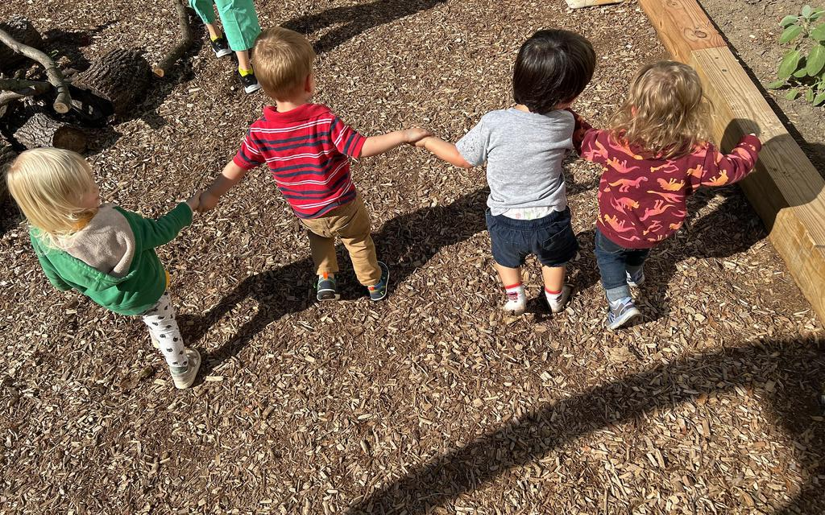
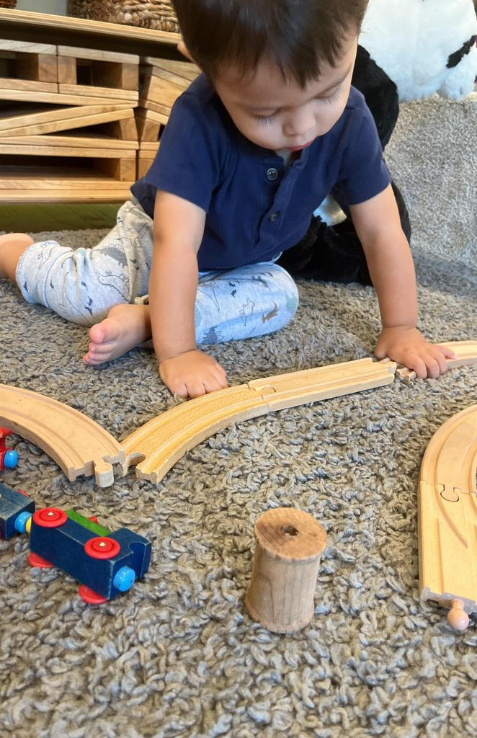
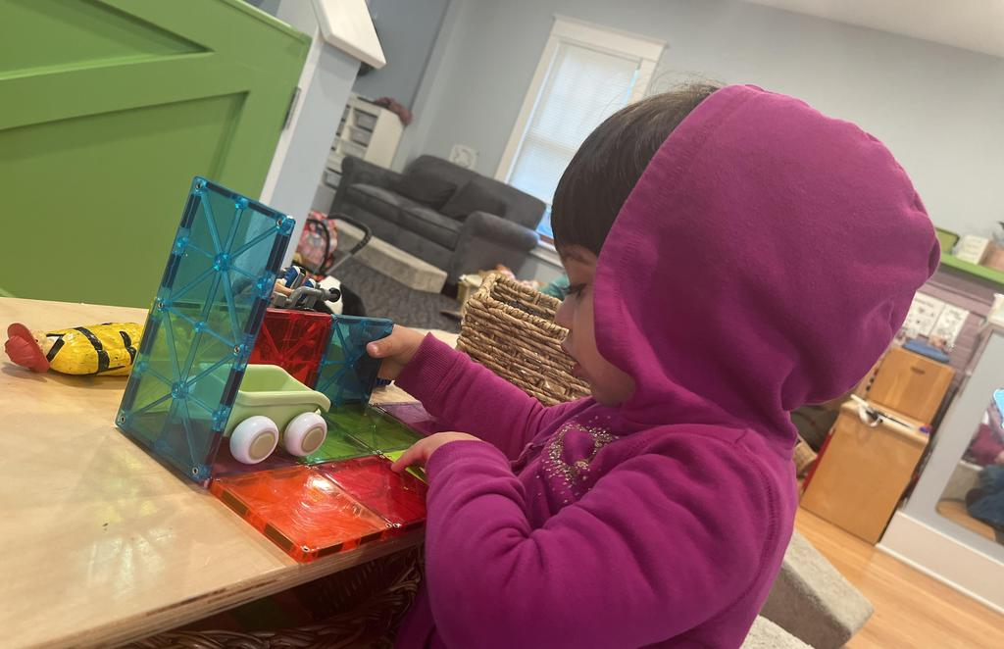
Connection
Joining things together, connecting objects, tying things together, opening and closing things. This can and often includes destruction/disconnection of what they’ve connected.
What Are They Learning?: Examining how things come together and apart, fine motor skills, cause and effect, spatial awareness, and pre-science and math skills, such as predicting and estimating.
Classroom Examples:
Building Blocks
Construction Sets
Threading and Lacing Toys
Puzzles
Train or Vehicle Sets
Art and Craft Materials
Glue/Scissors
Dancing

Slide 8
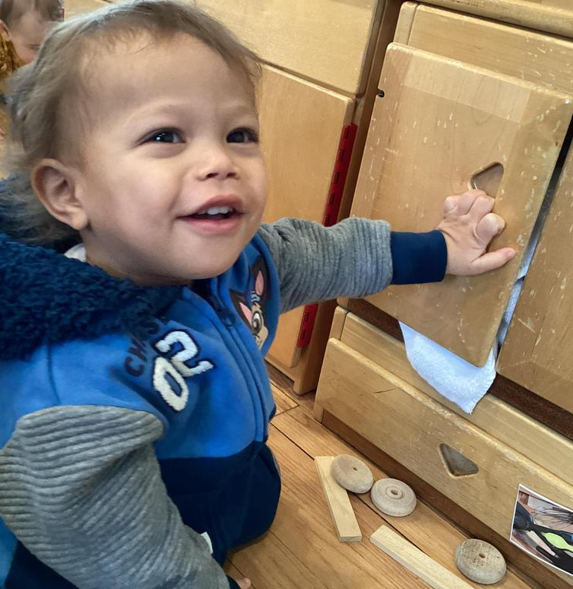
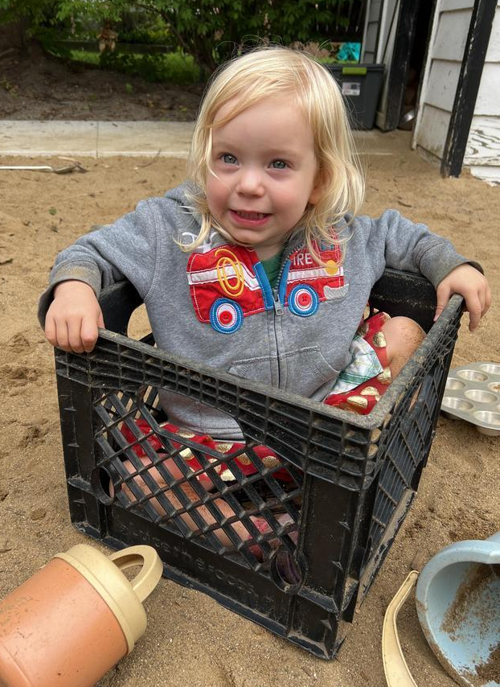
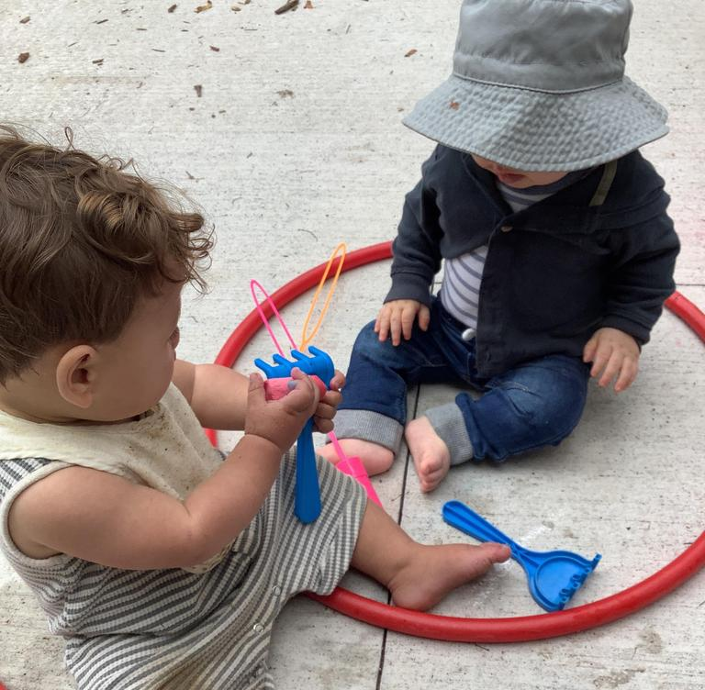
Enclosing
Containing things, creating borders or lines to form enclosures, building fences/walls around objects, borders around art, lining up food around their plate, filling up cups with water. Also includes enclosing themselves: climbing into boxes or cabinets.
What Are They Learning?: Building pre-math skills while planning their enclosures (measuring, predicting), fine and gross motor skills, object permanence.
Classroom Examples:
Building a Fort
Drawing Circles or Other Enclosed Shapes
Constructing Fences or Walls with Blocks
Playing with Hoops
Creating Enclosed Spaces with Play-Dough
Box Play
Nesting Dolls or Stacking Cups
Role-playing Activities
Hiding things.
Peek-a-boo.

Slide 9
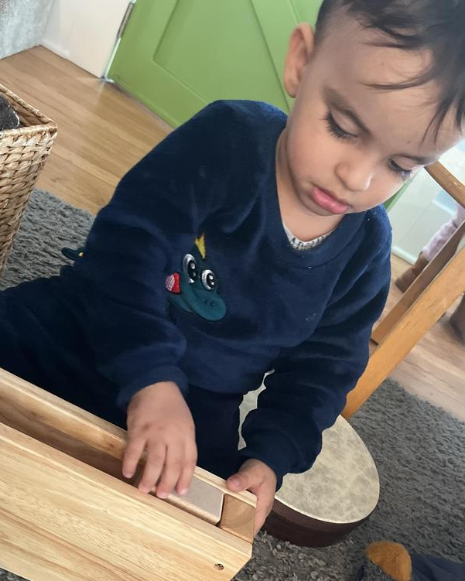
Enveloping
Covering objects or themselves, hiding things in discrete places. When your child envelops things, they are exploring the idea of object permanence. That is, the idea that things exist even after they have disappeared. Things that go away, come back.
Like Enclosure, except with Enveloping they are covering the entire item so it cannot be seen.
What Are They Learning?: Object permanence, fine and gross motor skills, problem-solving, visual tracking, and spatial awareness.
Classroom Examples:
Use posting toys, Russian dolls, nesting toys and shape sorters.
Wrap up baby dolls in blankets.
Play doctors or vets with plenty of bandages.
Wrap up parcels and use paper, newspaper, string, sellotape, ribbons.
They may enjoy dressing up, playing peekaboo, or even painting their entire paper or hand.

Slide 10
Orientation
Experimenting with different viewpoints: hanging upside down or views from on top or under things.
What Are They Learning?: Body and spatial awareness, gross motor skills, sensory and vestibular system stimulation.
Classroom Examples:
Stairs and ladders
Look through your legs
Hills
‘Driving’ vehicles and trolleys
Crates, planks and boards
Small world play
Climbing
Mirrors
Building Blocks
Tunnel
Puzzles
Yoga
Toy cameras

Slide 11
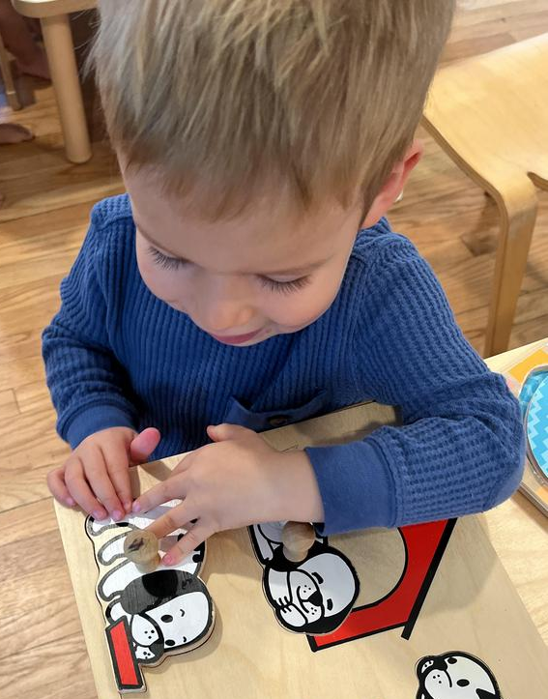
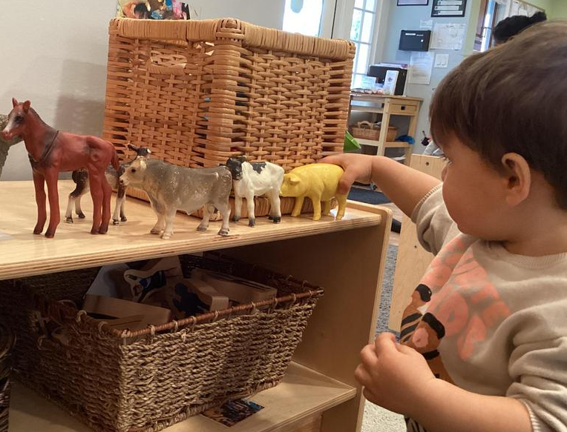
Positioning
Arranging objects or themselves. Lining up items a particular way, by size, color, etc. They might like tidying or placing things in unusual places.
What Are They Learning?: Recognizing differences and similarities, concentration, visual discrimination, and pre-math and science skills such as problem-solving, exploring patterns, classifying, and planning.
Classroom Examples:
Stacking and nesting
Putting in order
Positioning oneself
Sorting
Patterns and sequences
Puzzles
Drawing and painting
Block building
Toy vehicles

Slide 12
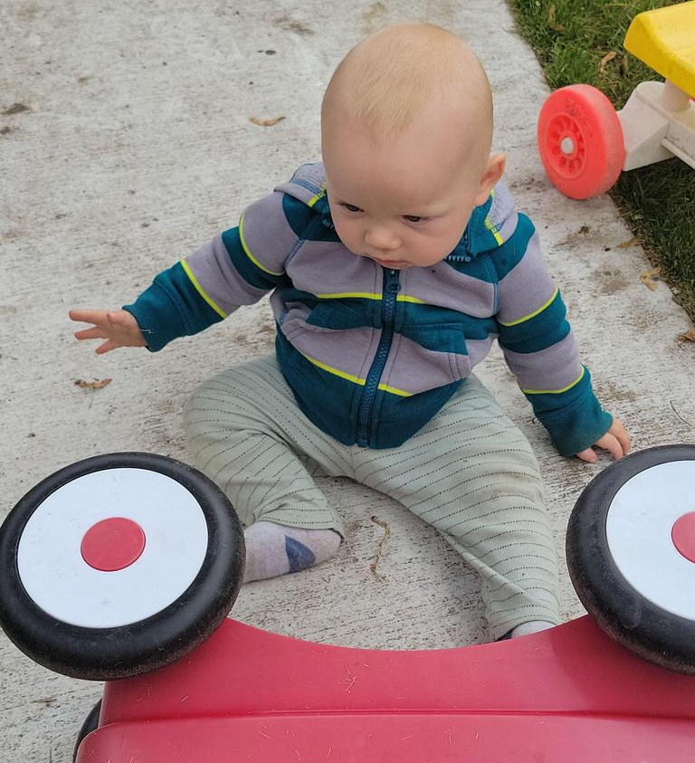
Rotation
Interest in things that spin or turn. They may like spinning themselves in circles, twisting things, or drawing circles.
What Are They Learning?: How things move, fine and gross motor, cause and effect.
Classroom Examples:
Gears
Toy vehicles
Balls
Streamers
Pin wheels
Dancing

Slide 13
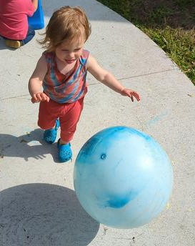
Trajectory
Interest in moving objects by throwing, dropping, or rolling. May include the trajectory of own body by jumping off things or bumping into things. Interacting with things that are already moving, like putting hands under running water.
What Are They Learning? Cause and effect, gross motor skills, visual tracking, body awareness, observing, and predicting.
Real-life Example: Throwing cup off the high chair. Throwing toys.
Throwing and catching
Rolling
Bubbles
Water Play with Cups and Funnels
Balls
Cars and vehicles
Ramps
Parachute
Streamers

Slide 14
Transforming
Combining or changing materials. They may experiment with mixing all their food and water at meals or enjoy mixing all the paint colors during art activities.
What Are They Learning?: Cause and effect, fine motor skills, pre-science skills such as observing and predicting.
Classroom Examples:
Cooking
Mud kitchen
Dress up clothes
Mixing colors
Malleable materials like clay or playdoh
Science experiments like baking soda and vinegar
Melting crayons
Butterfly kit
Oobleck activities

Slide 15
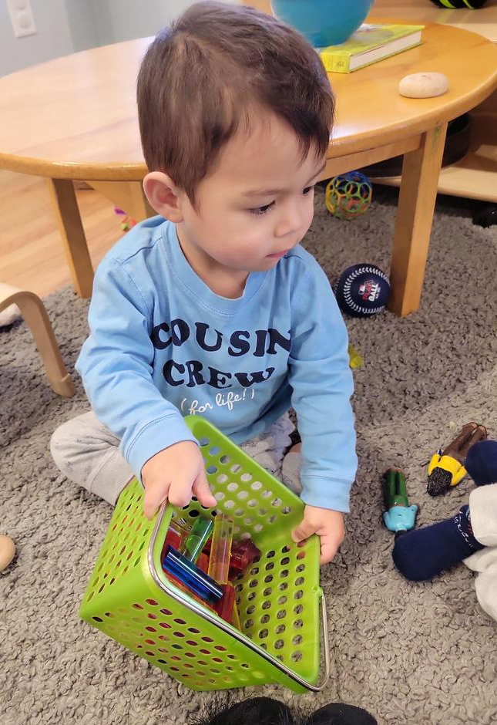
Transporting
Carrying objects in pockets, hands, bags. May also enjoy transporting oneself.
What Are They Learning?: Object permanence, fine and gross motor skills, spatial awareness, planning, and measuring (how much will fit?).
Classroom Examples:
Diggers, dump trucks and cranes
Wooden railway with freight trucks
Dumping.
Grocery carts, strollers.
Baskets, backpacks, handbags.
Cars and buses (with passengers).

Slide 16
How to support schema play:
Give your toddler chances to practice
If you notice your toddler working on a particular schema, you can offer toys and activities to encourage their exploration. If they love carrying things around, for example, they’re in a “transporting” schema—give them a small bucket with a handle to carry objects.
Offer appropriate alternatives
Schema play can sometimes feel frustrating to parents and caregivers. You may be at a special outing and all your child wants to do is spin the wheels on their stroller. Whenever possible, allow them to continue their play.
If their behavior is disruptive or inconvenient, try giving them an acceptable alternative.
Resist showing them how to do it “right”
Schemas are developed through seemingly endless repetition that can include lots of trial and error. If your toddler is struggling to do something, let them keep trying on their own as long as they aren’t getting too frustrated.

Slide 17
Thank You
Jade Teachey – jade.teachey@gretchenshouse.com
Kelly Lessard – kelly.lessard@gretchenshouse.com
Training Credit Check Out Code: 72A2

Slide 18
https://www.onehundredtoys.com/understanding-schema-play-in-toddlers/ https://lovevery.com/community/blog/child-development/what-are-play-schemas-and-how-do-they-help-your-toddler-learn/ https://reachformontessori.com/play-schemas-fun-activities-that-help-your-child-develop/

